Slide 1
Wave Motion

Slide 2
Waves are everywhere in nature
Sound waves,
visible light waves,
radio waves,
microwaves,
water waves,
sine waves,
telephone chord waves,
stadium waves,
earthquake waves,
waves on a string,
slinky waves

Slide 3
Waves
Wave: a disturbance that transfers energy through matter or space.
particles of matter don’t move along with wave.
Medium: substance or region through which a wave is transmitted.
Exception to rule: light can be transmitted through a vacuum.

Slide 4
Types of Waves
Mechanical: A mechanical or material wave is a wave that needs a medium to travel
Electromagnetic: a wave propagated through space or matter by oscillating electric and magnetic fields: in a vacuum it travels at the speed of light

Slide 5
Vibrations and Waves
How are waves generated?
Most waves are caused by vibrating objects.
The sound waves produced by a singer are caused by vibrating vocal cords.
Electromagnetic waves may be caused by vibrating charged particles.
For mechanical waves, the particles in the medium through which the wave passes vibrate, too.

Slide 6
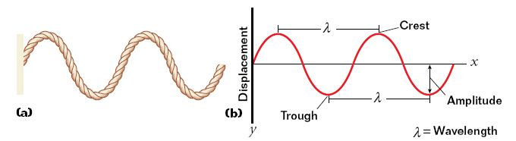
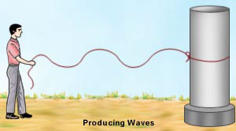
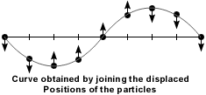
Transverse waves
Transverse waves have perpendicular motion.
transverse wave: a wave in which the particles of the medium move perpendicularly to the direction the wave is traveling

Slide 7
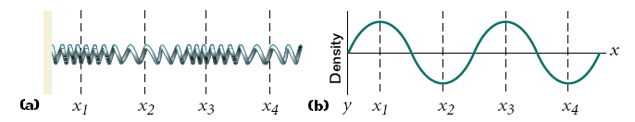
Longitudinal waves
Longitudinal waves have parallel motion.
longitudinal wave: a wave in which the particles of the medium vibrate parallel to the direction of wave motion

Slide 8
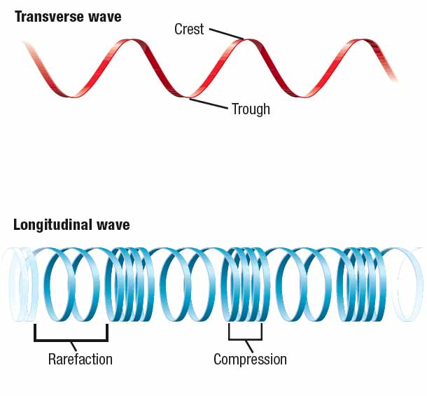
Waves have crests and troughs or compressions and rarefactions.
crest: the highest point of a wave
trough: the lowest point of a wave
compressions: the crowded areas of a longitudinal wave
rarefactions: the stretched-out areas of a longitudinal wave

Slide 9
Surface Waves
The particles in a surface wave move both perpendicularly and parallel to the direction in which the wave travels.
surface waves: waves that occur at the boundary between two different mediums, such as water and air

Slide 10
Wave Properties
What are some ways to measure and compare waves?
Amplitude and wavelength are measurements of distance.
Period and frequency are measurements based on time.

Slide 11
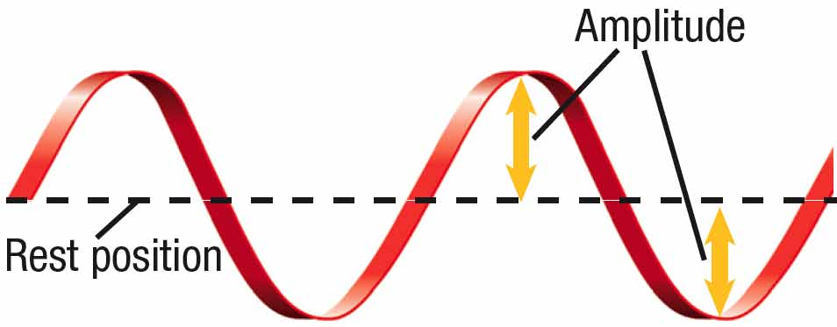
Amplitude
Amplitude: the maximum distance that the particles of a wave’s medium vibrate from their rest position
for a transverse wave, measured from the rest position to the crest or the trough
expressed in the SI unit meters (m)

Slide 12
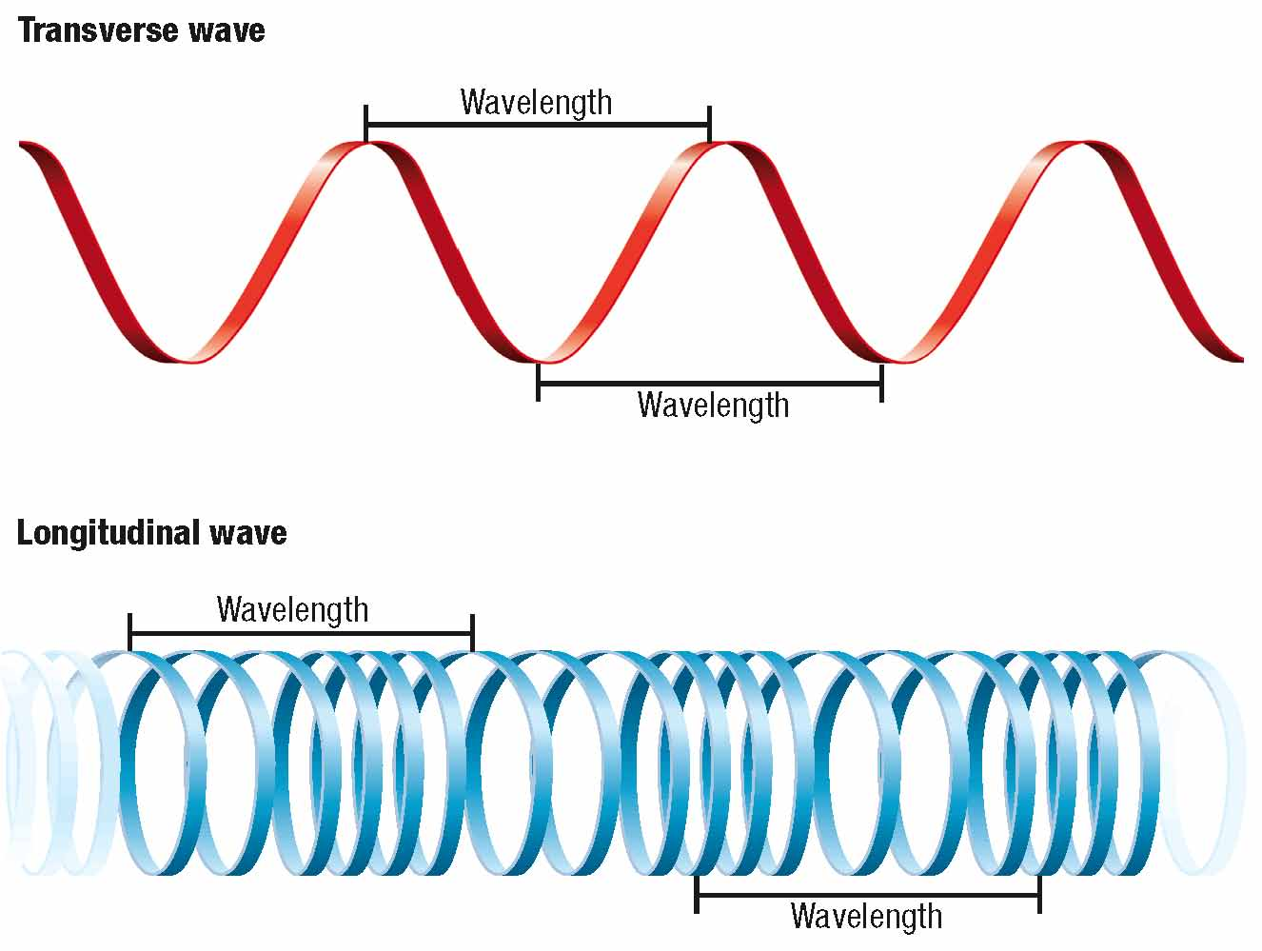
Wavelength
wavelength: the distance from any point on a wave to an identical point on the next wave
for a transverse wave, measured from crest to crest or trough to trough
represented by the symbol λ
expressed in the SI unit meters (m)

Slide 13
Amplitude and wavelength tell you about energy.
larger amplitude = more energy
shorter wavelength = more energy

Slide 14
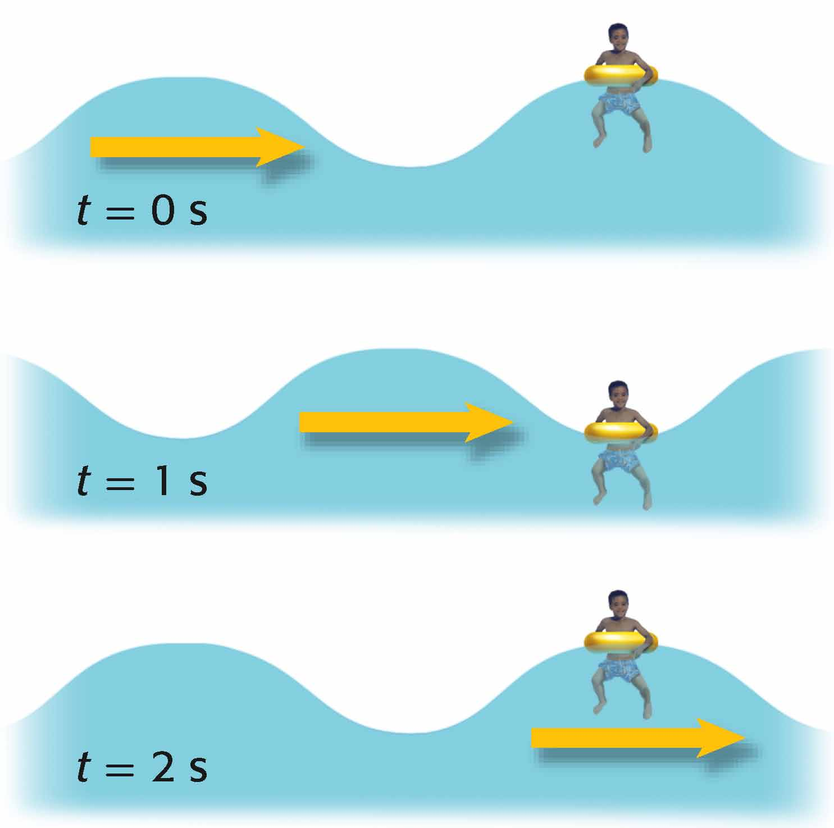
period
The period is a measurement of the time it takes for a wave to pass a given point.
period: in physics, the time that it takes a complete cycle or wave oscillation to occur
represented by the symbol T
expressed in the SI unit seconds (s)
in the diagram, T = 2 s

Slide 15
Frequency
Frequency is a measurement of the vibration rate.
frequency: the number of cycles or vibrations per unit of time; also the number of waves produced in a given amount of time
represented by the symbol f
expressed in the SI unit hertz (Hz), which equals 1/s
in the diagram, f = 0.5 Hz

Slide 16
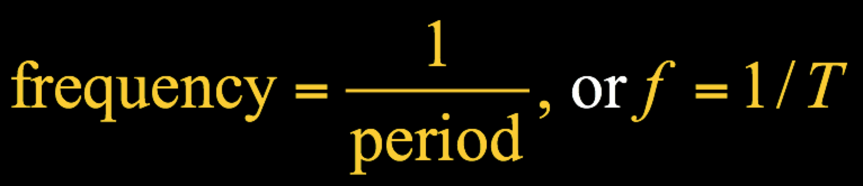
The frequency and period of a wave are related.
The frequency is the inverse of the period.

Slide 17
Wave Speed
How can you calculate the speed of a wave?
The speed of a wave is equal to wavelength divided by period, or to frequency multiplied by wavelength.

Slide 18

Wave Speed
Wave speed equals wavelength divided by period.
speed = distance/time
Wave speed equals frequency times wavelength.
wave speed = frequency × wavelength, or v = f × λ

Slide 19
The speed of a wave depends on the medium.
In general, wave speed is greatest in solids and least in gases.
In a given medium, the speed of waves is constant.
Kinetic theory explains differences in wave speed.
Light has a finite speed.
the speed of light (c) = 3.00 × 10⁸ m/s
for electromagnetic waves, c = f × λ

Slide 20
Math Skills
Wave Speed
The string of a piano that produces the note middle C vibrates with a frequency of 262 Hz. If the sound waves produced by this string have a wavelength in air of 1.30 m, what is the speed of the sound waves?
List the given and unknown values.
Given: frequency, f = 262 Hz
wavelength, λ = 1.30 m
Unknown: wave speed, v = ? m/s

Slide 21
Write the equation for wave speed.
v = f × λ
Insert the known values into the equation, and solve.
v = 262 Hz × 1.30 m
v = 341 m/s

